Slide 1


Data Visualization & Storytelling
By:
Sai Sharan Reddy Manne
Data Analyst

Slide 2


Today's agenda
Project recap
Problem
The Analytics team
Process
Insights
Summary

Slide 3

Objectives:
The main goal of the project is to improve decision-making through visualized insights.
Scope:
Data sources, Data cleaning, and analysis.
Expected Outcome:
Maintaining a clean data, Performing required analysis.
Project Recap

Slide 4

Problem
In the recent analysis:
The data sets contain huge amounts of data and multiple information.
We found multiple Duplicate values and many unwanted columns which did not help for our analysis.
We can select the required data before downloading which avoids duplicate and unwanted data in the dataset.

Slide 5
Andrew Fleming
Chief Technical Architect
The Analytics team
Marcus Rompton
Senior Principal
Sai Sharan Reddy Manne
Data Analyst

Slide 6
Process
1
Data Collection
2
Data Cleaning
3
Analysis
4
Visualization
5
Insights

Slide 7

Insights
Unique Categories
Most Posts
Content Categories
Popular Category

Slide 8
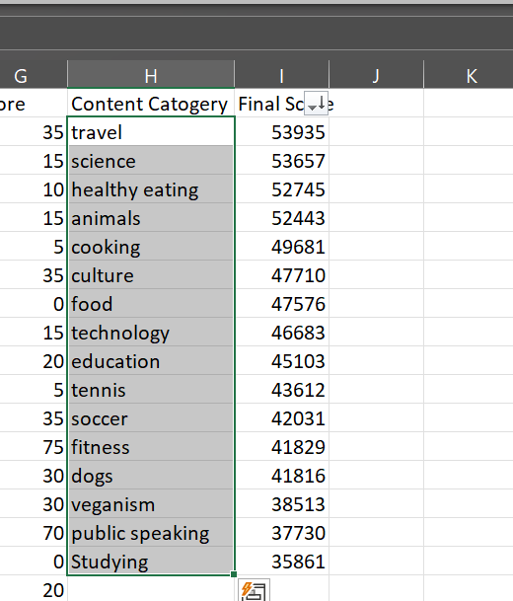
Top 5 Content Categories:
Top 5 content categories are – Travel, Science, Healthy eating, Animals and Cooking.
Unique Categories:
There are 16 Unique Categories.

Slide 9
Most Popular Category:
Most popular category is Travel.
Month with the Most Posts:
December is the month with most posts.

Slide 10

Top 5 content categories: Travel, Science, Healthy eating, Animals and Cooking.
Unique Categories: 16
Most popular category: Travel.
Month with the Most Posts: December
Summary

Slide 11
Thank you!
ANY QUESTIONS?

